Slide 1
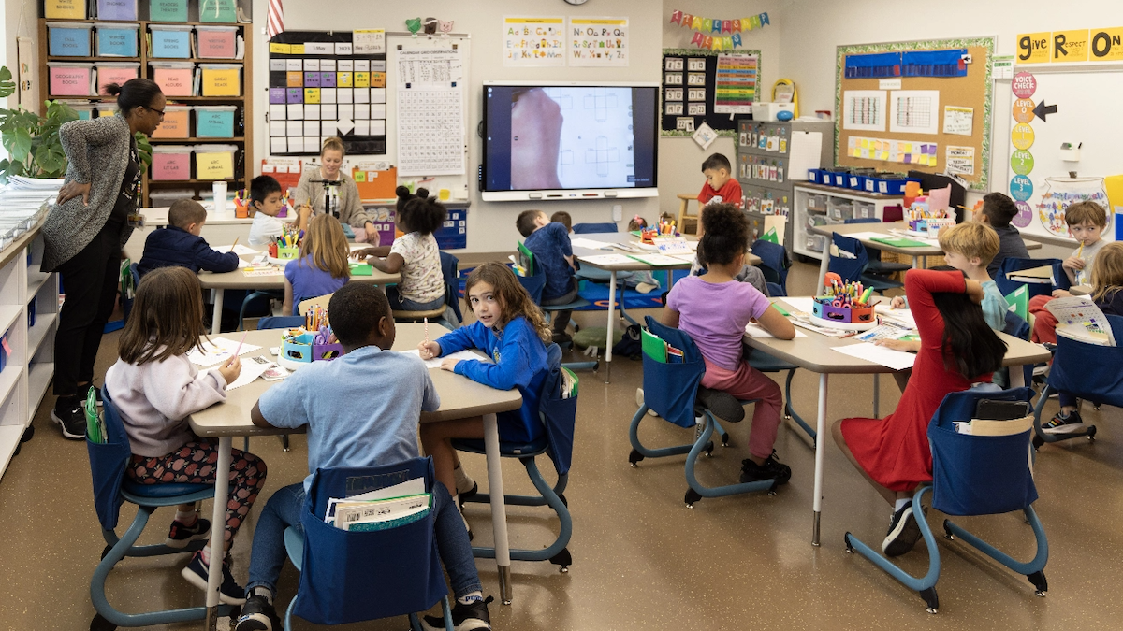
Bridge: Transforming Classroom Engagement
Garrett Williams

Slide 2



Meet Bridge, an interactive learning platform
Interactive Learning Platform
Active Participation
Engaging Experiences
Bridge transforms passive classroom experiences into active, engaging, and competitive learning environments
Every student is excited to participate, leading to better information retention
Bridge creates a vision where learning is fun and captivating for students
With Bridge, the classroom of the future is here, where students are eager to learn and retain more information than ever before.

Slide 3
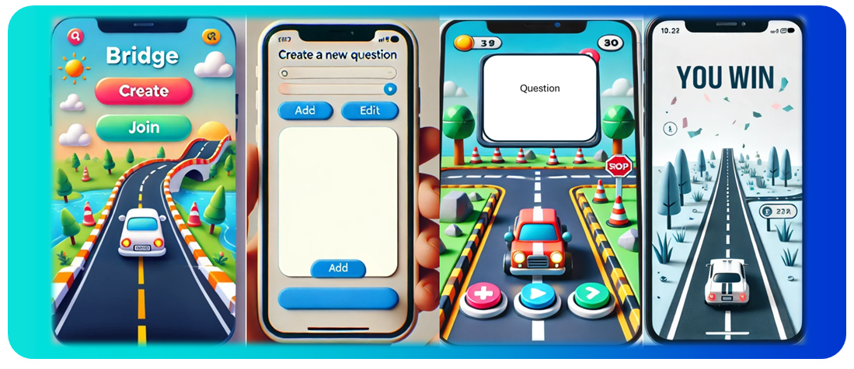
Bridge Mock-Up: The application students love

Slide 4
The challenge in todays classroom…
Classrooms today struggle with student disengagement and lack effective tools to make learning interactive
Students lose focus and retention suffers when lessons lack interactivity, making it harder for teachers to achieve desired learning outcomes
Teachers want an easy-to-use solution that drives engagement, improves knowledge retention, and creates a fun learning environment

Slide 5
Bridge: Your Interactive Learning Solution
Bridge: Your Interactive Learning Solution
Gamification
Real-time Feedback
Customizable Challenges
Bridge incorporates game-like elements to make learning more engaging and enjoyable for students
Bridge provides immediate feedback to students, allowing them to track their progress and identify areas for improvement
Teachers can create personalized learning challenges that cater to the unique needs and abilities of their students
Interactive Environment
Improved Retention
Fun Learning
Bridge fosters a more interactive classroom where students actively participate, compete, and learn together
With Bridge, students are more engaged and retain information for longer, leading to better learning outcomes
Bridge makes the learning process enjoyable, ensuring that students have fun while acquiring new knowledge and skills

Slide 6



Key Features of Bridge
Tailor questions and difficulty levels to fit the curriculum
Motivate students with points, badges, and rankings
Track and assess student progress with easy-to-read reports and data visualizations

Slide 7



What are the benefits for teachers and students?
Keeps students motivated and excited through games, quizzes, and challenges
Interactive and repetition-based learning leads to better retention of key concepts
Teachers receive instant feedback on student progress, enabling timely support

Slide 8


What are the benefits for teachers and students?
Enhanced Engagement
Improved Retention
Real-Time Insights

Slide 9
Flexible and Transparent Pricing Options
Basic classroom features at no cost, perfect for individual teachers
Subscription with advanced features like analytics, custom quizzes, and private leagues—ideal for schools and districts
Our pricing structure provides flexibility for educators to scale according to classroom needs, maximizing value for cost

Slide 10
Pricing options for Bridge
Plan
Price
Free Plan
Free
Individual Plan
$9 per month
Institutional Plan for up to 100 users
$99 per month

Slide 11
“Bridge has completely transformed my classroom. My students are more engaged and enthusiastic about their learning than ever before.”
MRS. EMILY JOHNSON, 5TH GRADE TEACHER

Slide 12






Join the Bridge Community

Slide 13


Ready to learn with Bridge?
Contact us at bridgeio@bridge.net

